Slide 1
Simulation & Applications
ROS Gazebo, Object Detection & Tracking, Speech Recognition

Slide 2
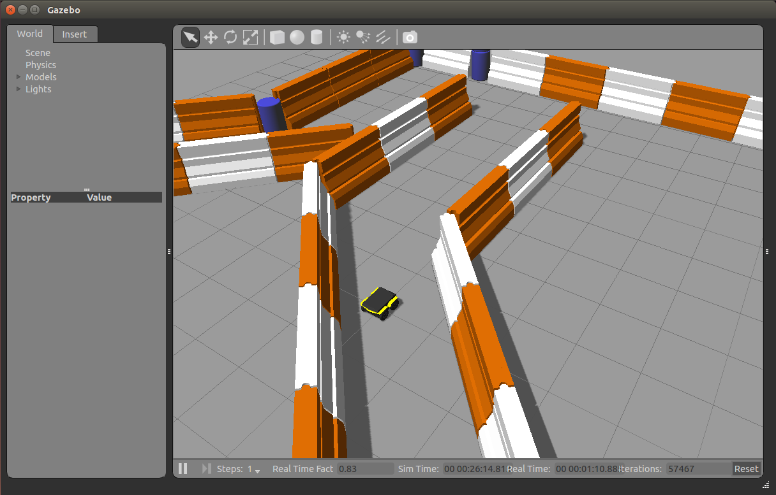
ROS Gazebo
Simulation package
Includes customizable physics/collision/lighting models
Create a world with 100+ built-in and more open-source objects
Runs through ROS nodes so other packages like gmapping, amcl, and rviz can retrieve data and control the robot

Slide 3
Other Simulators
Arbotix

Slide 4
Object Detection & Tracking
vision_visp
visp follower
ROS Mask RCNN, ROS YOLO,
vision_opencv

Slide 5
Speech Recognition
Pocketsphinx
speech_recog_uc
gspeech

Slide 6
Other Applications
Controller teleoperation, speech teleoperation, visual teleoperation, track/follow a person’s face or skeleton, pan-and-tilt camera on servos, task execution using SMACH/behavior trees/actionlib, virtual reality teleoperation, augmented reality, dynamic reconfiguration of node parameters, robot diagnostics, web GUIs, training simulated autonomous cars, 3D camera mapping, ROS Qt local GUIs, MoveIt!

Slide 7
Final Exam
Work with each other to complete the Final Exam

Slide 8
The End… NOT
We want you to stay involved in the ROS community at Crane!
Future Activities:
April – Suggest a NISE project using ROS. There is a huge push for autonomy from leadership but any sort of robotics can use ROS and may align closer to your branch/division’s work
May – Director’s Cup teams will be formed. Tell your Department Heads / Team Leads you want to be on the team!
May – Attend ROS Course Reboot
June - July – Help mentor SEAP Interns
June - September – Help develop demonstrations for ROS Showcase

